Slide 1


Airspace Management
Civil Aviation University of China
Civil Aviation University of China
Lesson 2

Slide 2
Learning Objectives
Objective:
State the objective of ASM
State the functions of ASM
Define the three types of Special Use Airspace
List the names of the part of airspace for the use of commercial flights
State the purpose of airspace classification
References:
EUROCONTROL HANDBOOK FOR AIRSPACE MANAGEMENT
EUROCONTROL AIRSPACE STRATEGY FOR THE ECAC STATES

Slide 3
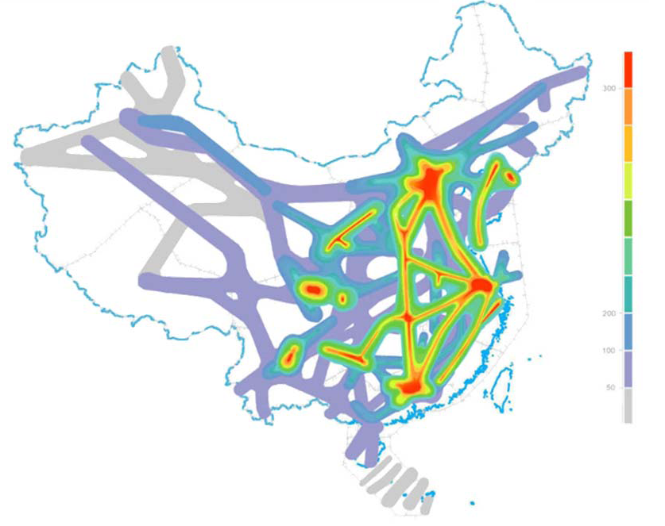
Airspace Users and Activities
Airlines – commercial transportation
Military – Training, Exercises, Operations
Police, Customs – Crime Prevention
GA – All other, including Leisure, Sports…
All these activities should be accommodated
Commercial Air Traffic in China

Slide 4
Objectives of ASM
The objective of ASM is to maximize, within a given airspace structure, the utilization of available airspace by dynamic time-sharing and, at times, segregation of airspace among various categories of users based on short-term needs.
Close co-operation between the appropriate authorities on expected and actual utilization of the temporary reserved airspace should result in information being readily available to all parties concerned, i.e. commercial air transport, military operational air traffic and general aviation.

Slide 5
Functions of ASM
collection and evaluation of all requests which require temporary airspace allocation;
planning and allocation of the required airspace to the users concerned where segregation is necessary;
activation or de-activation of such airspace within adequately narrow time tolerances, in close co-operation with ATC units and civil or military units concerned.
dissemination of detailed information, both in advance and in real time, to all parties concerned.

Slide 6
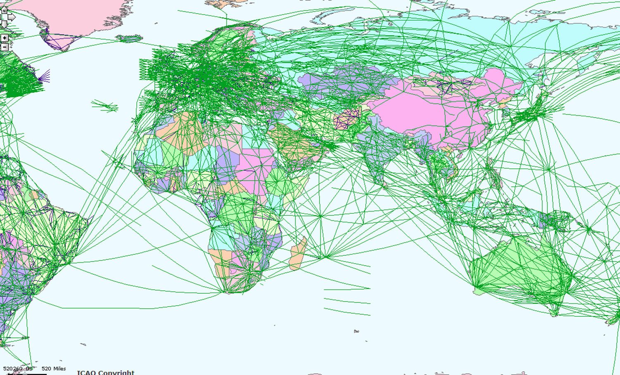
World Air Traffic Routes

Slide 7
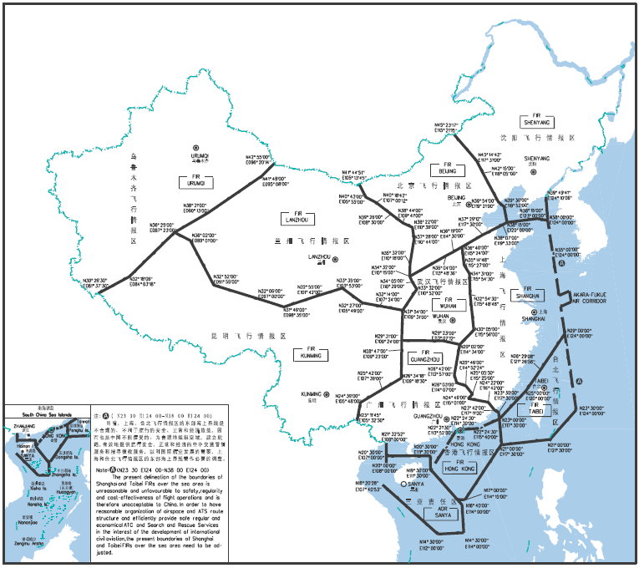
Flight Information Regions (FIR)
Notes:
Flight information region (FIR). An airspace of defined dimensions within which flight information service and alerting
service are provided.

Slide 8
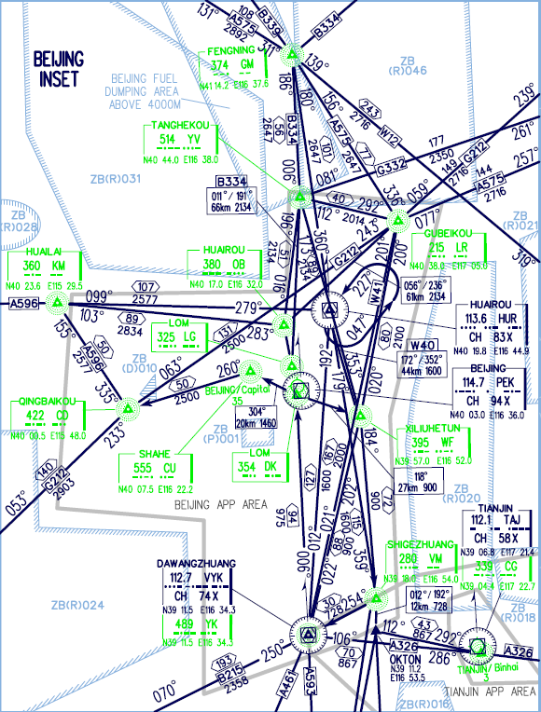
Airspace reservations and restrictions
Reservations
Special Use Airspace
Prohibited Area
Restricted Area
Danger Area

Slide 9

Airspace for Commercial Flights
Airways and Air-routes (AWY)
Terminal Control Areas (TMA)
Aerodrome Control Zones (CTZ)
AWY
AWY
TMA
Uncontrolled Airspace
TMA
CTZ
CTZ

Slide 10
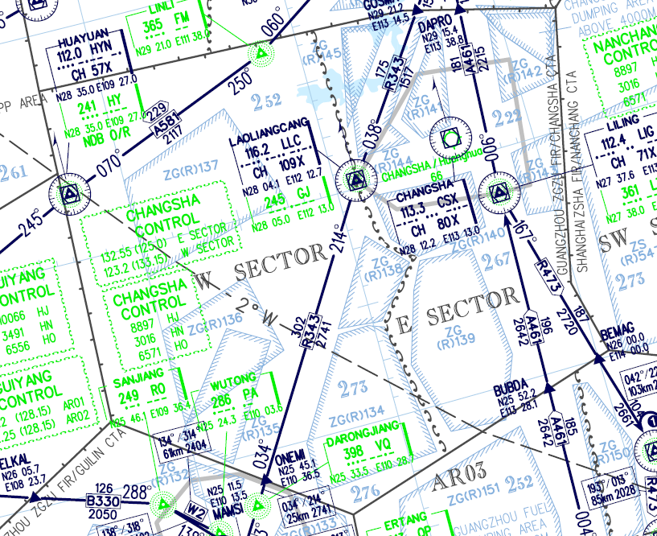
Controlled Airspace
Control Areas
Control Sectors

Slide 11

Airspace Design
Design of Airspace Structures
Design of Restricted Airspace and Reserved Airspace
Design of Airways and Sectors
Design of Terminal Airspace

Slide 12
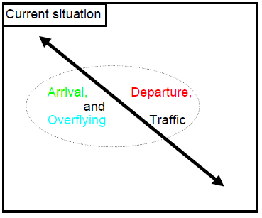
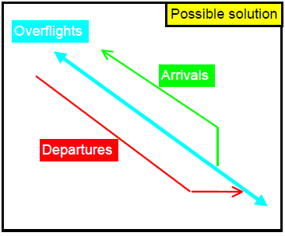
Airspace Design Examples
Establish Specialized Routes

Slide 13
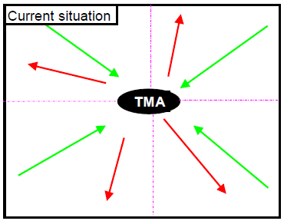
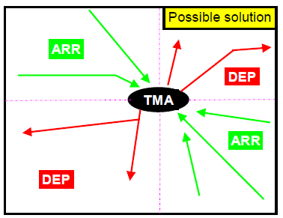
Airspace Design Examples
Established Specialized Sectors

Slide 14
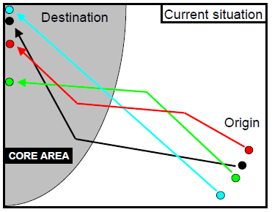
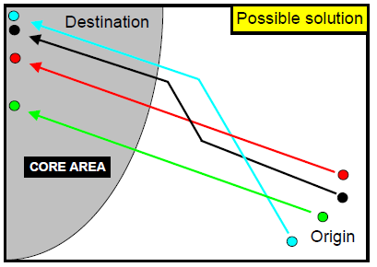
Airspace Design Examples
Organize ATS Routes

Slide 15
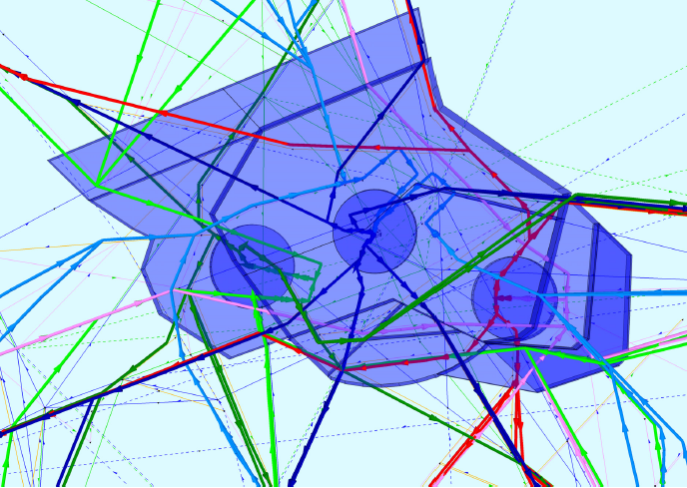
Airspace Design Examples

Slide 16
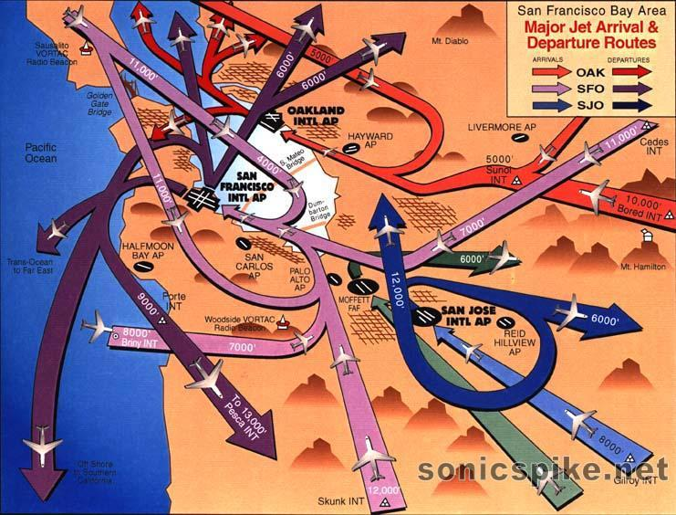
Airspace Design Examples
San Francisco Bay Area – West Flow

Slide 17
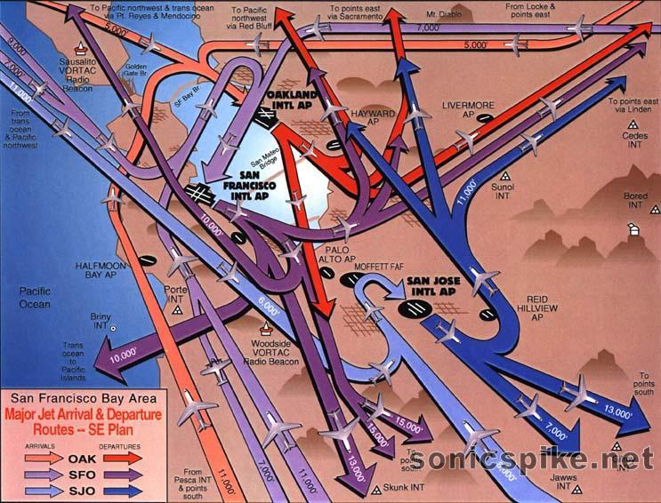
Airspace Design Examples
San Francisco Bay Area – East Flow

Slide 18
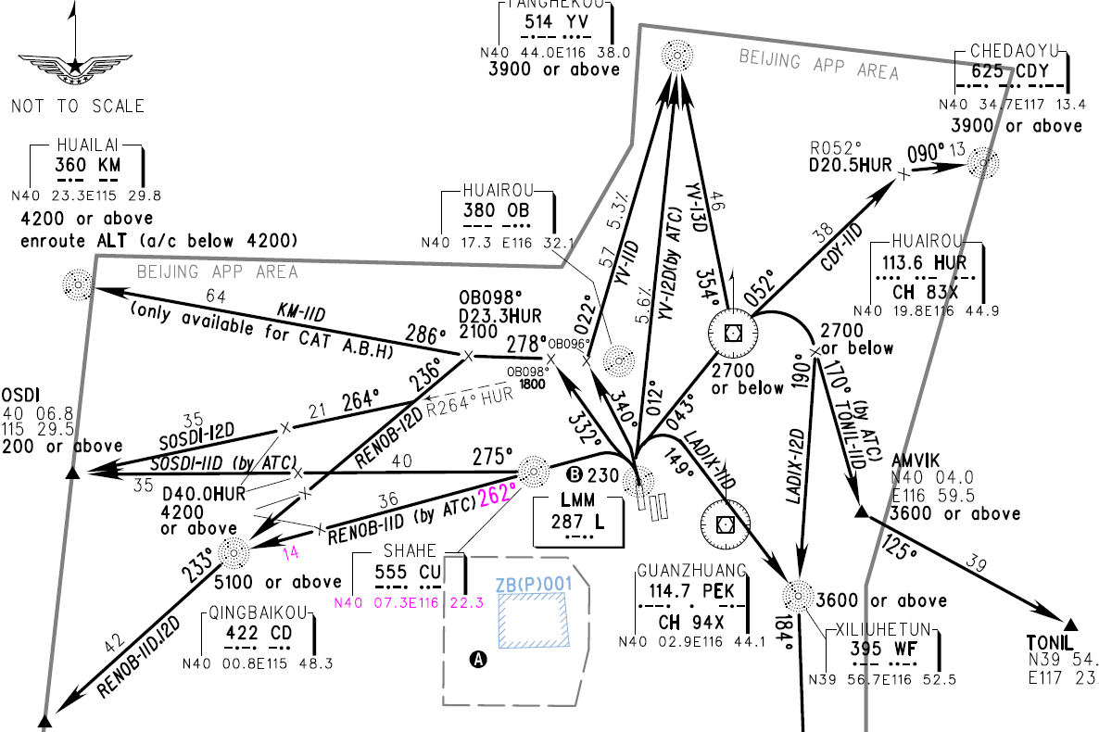
Airspace Design Examples
Departure from Runway 36L Beijing Capital

Slide 19
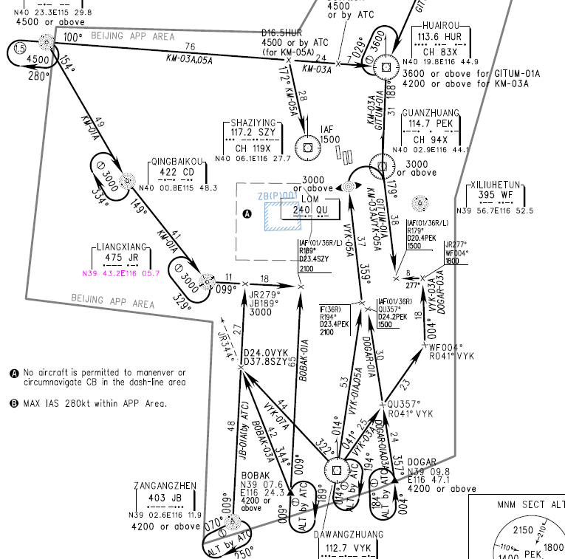
Airspace Design Examples
Arrivals to Land North at Beijing Capital

Slide 20
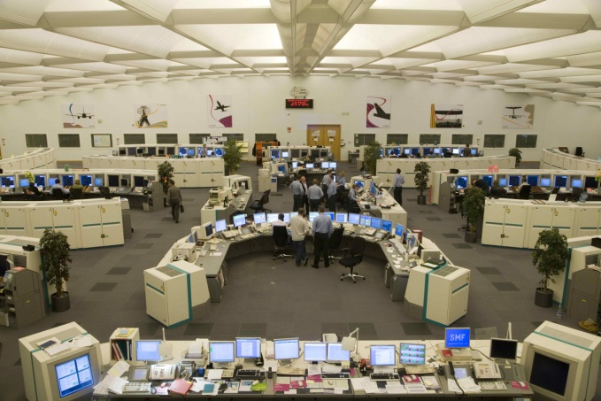
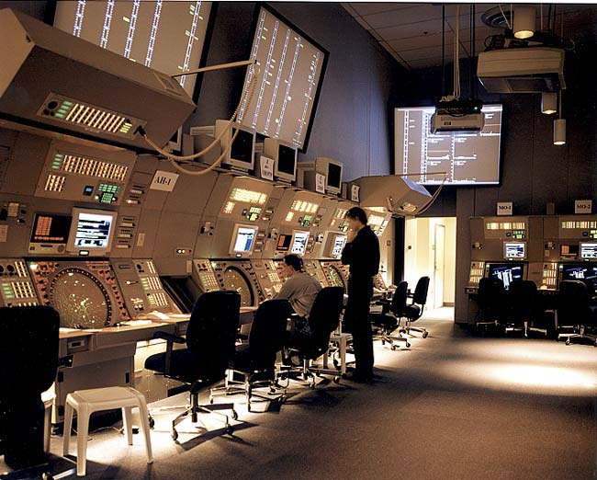
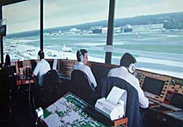
Air Traffic Control Units
Airways and Air-routes ----- Area/Airway Control Centre
Terminal Control Areas ----- Terminal/Approach Control
Aerodrome Control Zone ----- Tower control

Slide 21
Classification of Airspace
The purpose of airspace classification
Different degree of control for different activities
Different rules for different activities
Different service for different activities
Different equipage requirements for different activities

Slide 22
Classification of Airspace
Class G
FL660
Class B UIR
FL245
Class G
Airways
CTA
Class A
Class F Advisory Route
Class G
TMA
Class D
Class E
MATZ
Class A
Control Zone
CTR
ATZ
UK Airspace Classification

Slide 23
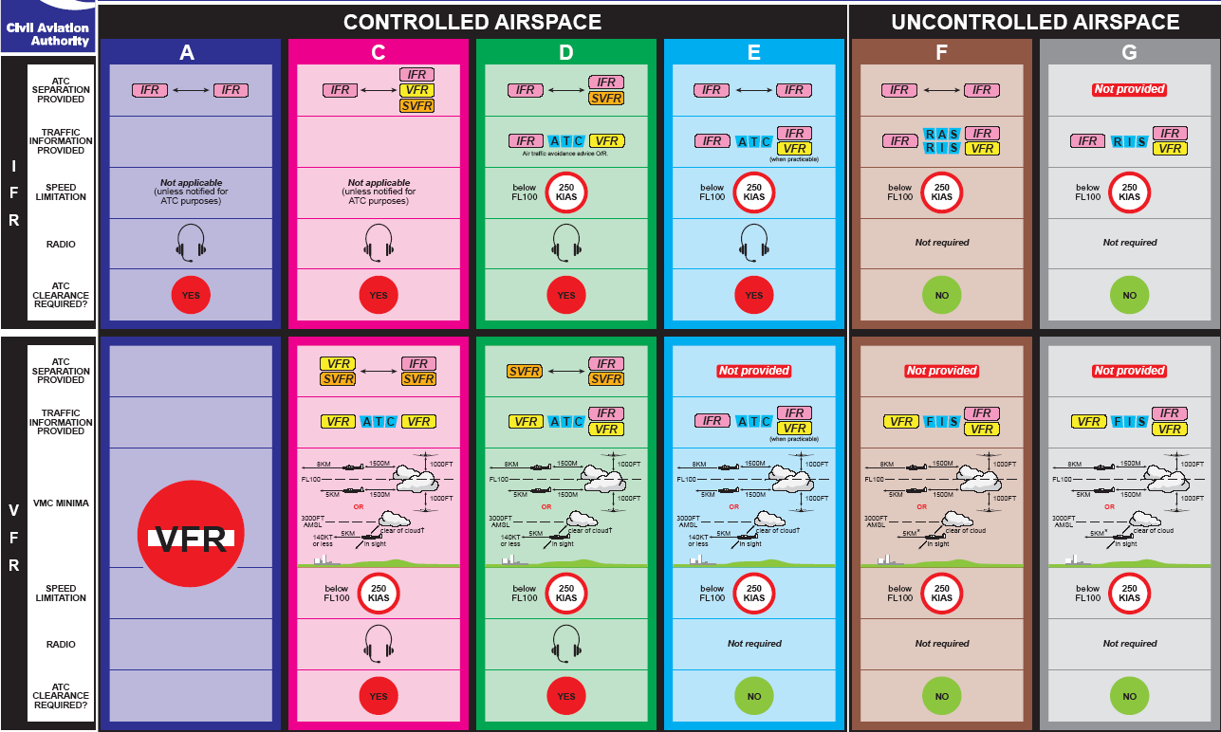
Classification of Airspace
UK Airspace Classification

Slide 24
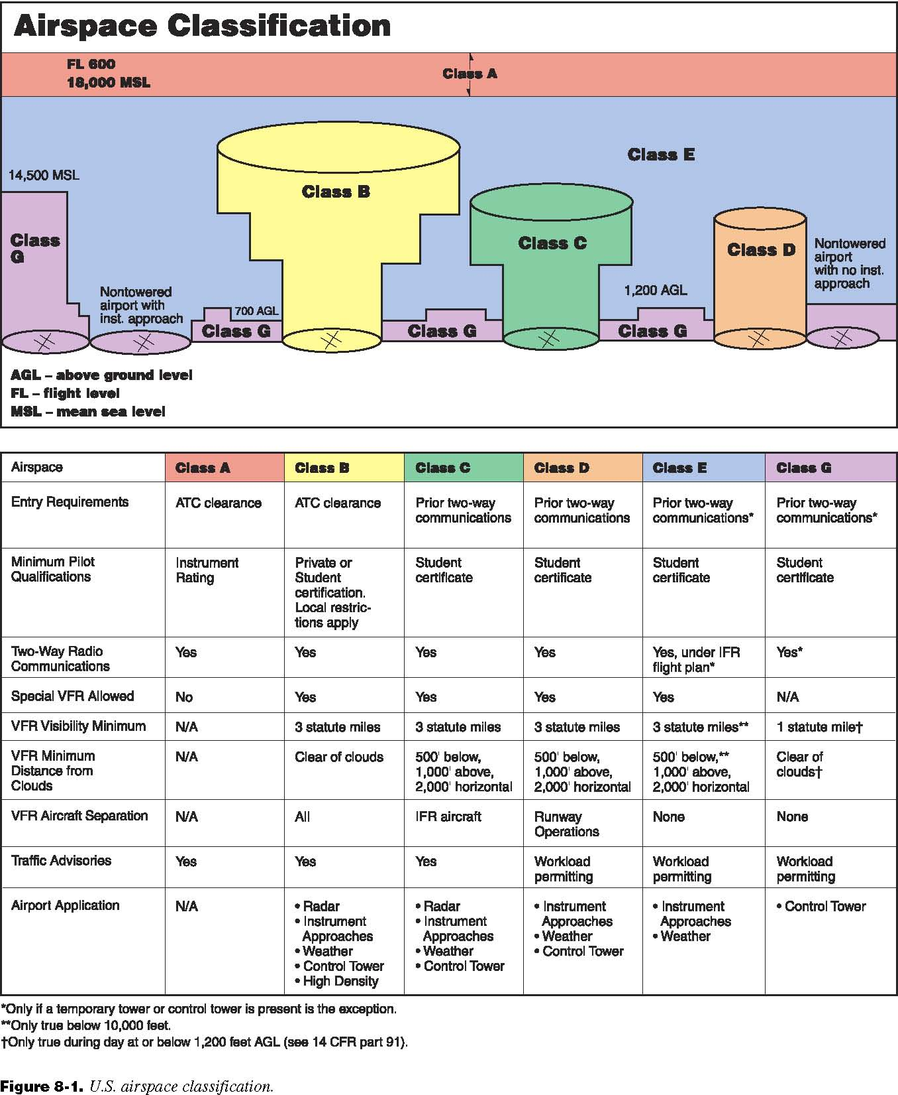
Classification of Airspace
US Airspace Classification

Slide 25
Classification of Airspace
US Airspace Classification
US Airspace Classification

Slide 26
China Airspace Classification
Classification of Chinese airspace
A – High level airspace
B – Medium and low level airspace
C –Terminal (Approach) control area
D – tower control zone
Unclassified in fact!
All airspace is controlled due to historical reasons

Slide 27
Simplified Airspace Organization
Intended
Traffic
Environment
N
FL X
Known
Traffic
Environment
K
FL Z
N
U
K
Unknown
Traffic
Environment

Slide 28
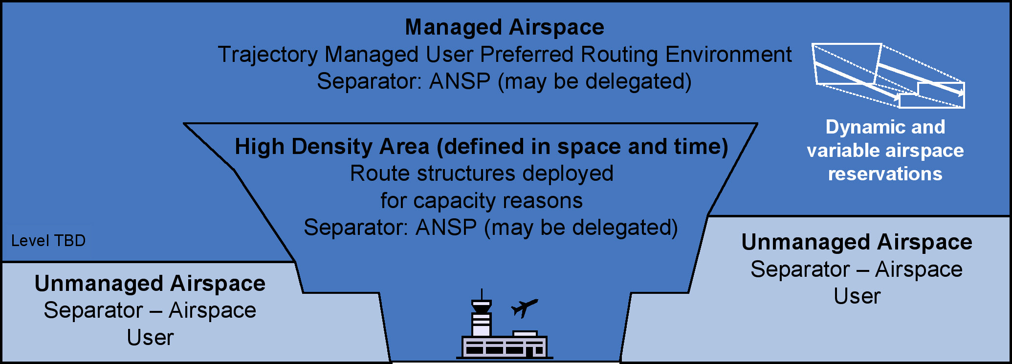
Future Airspace Structure

Slide 29

Questions
What are the functions of ASM?
What are three types of SUA?
Why is airspace classified?
What are the blocks of airspace for commercial flights?
What ATC units are responsible for these blocks of airspace?
Should Chinese airspace be “reclassified”?

